Slide 2
Overview
Part 1 – Gate Circuits and Boolean Equations
  2-1 Binary Logic and Gates
  2-2 Boolean Algebra
  2-3 Standard Forms
Part 2 – Circuit Optimization
  2-4 Two-Level Optimization
  2-5 Map Manipulation
  2-6 Pragmatic Two-Level Optimization (Espresso)
  2-7 Multi-Level Circuit Optimization
Part 3 – Additional Gates and Circuits
  2-8 Other Gate Types
  2-9 Exclusive-OR Operator and Gates
  2-10 High-Impedance Outputs
Chapter 2 - Part 1 <number>

Slide 3
2-1 Binary Logic and Gates
Digital circuits are hardware components (based on transistors) that manipulate binary information
We model the transistor-based electronic circuits as logic gates.
  Designer can ignore the internal electronics of a gate
Chapter 2 - Part 1 <number>

Slide 4
Binary Logic
Binary variables take on one of two values.
Logical operators operate on binary values and binary variables.
Basic logical operators are the logic functions AND, OR and NOT.
Logic gates implement logic functions.
Boolean Algebra: a useful mathematical system for specifying and transforming logic functions.
We study Boolean algebra as a foundation for designing and analyzing digital systems!
Chapter 2 - Part 1 <number>

Slide 5
Binary Variables
Recall that the two binary values have different names:
  True/False
  On/Off
  Yes/No
  1/0
We use 1 and 0 to denote the two values.
Variable identifier examples:
  A, B, y, z, or X₁ for now
  RESET, START_IT, or ADD1 later
Chapter 2 - Part 1 <number>

Slide 6
Logical Operations
The three basic logical operations are:
  AND
  OR
  NOT
AND is denoted by a dot (·).
OR is denoted by a plus (+).
NOT is denoted by an overbar ( ¯ ), a single quote mark (') after, or (~) before the variable.
Chapter 2 - Part 1 <number>

Slide 7
Notation Examples
Examples:
  is read “Y is equal to A AND B.”
  is read “z is equal to x OR y.”
  is read “X is equal to NOT A.”
Y
=
A
⋅
B
z
=
x
+
y
X
=
A
Note: The statement:
  1 + 1 = 2 (read “one plus one equals two”)
is not the same as
  1 + 1 = 1 (read “1 or 1 equals 1”).
Chapter 2 - Part 1 <number>

Slide 8
Operator Definitions
Operations are defined on the values "0" and "1" for each operator:
AND
OR
NOT
0 · 0 = 0
0 + 0 = 0
0
=
1
0 · 1 = 0
0 + 1 = 1
1
=
0
1 · 0 = 0
1 + 0 = 1
1 · 1 = 1
1 + 1 = 1
Chapter 2 - Part 1 <number>

Slide 9
Truth Tables
Truth table − a tabular listing of the values of a function for all possible combinations of values on its arguments
Example: Truth tables for the basic logic operations:
AND
OR
X | Y | Z = X+Y
0 | 0 | 0
0 | 1 | 1
1 | 0 | 1
1 | 1 | 1
NOT
X
Y
Z = X·Y
X
Z
=
X
0
0
0
0
1
0
1
0
1
0
1
0
0
1
1
1
Chapter 2 - Part 1 <number>

Slide 10
Logic Function Implementation
Using Switches
  For inputs:
    logic 1 is switch closed
    logic 0 is switch open
  For outputs:
    logic 1 is light on
    logic 0 is light off.
  NOT uses a switch such
  that:
    logic 1 is switch open
    logic 0 is switch closed
Switches in parallel => OR
Switches in series => AND
Normally-closed switch => NOT
C
Chapter 2 - Part 1 <number>

Slide 11
Logic Function Implementation (Continued)
Example: Logic Using Switches
Light is on (L = 1) for
  L(A, B, C, D) =
  and off (L = 0), otherwise.
Useful model for relay circuits and for CMOS gate circuits, the foundation of current digital logic technology
B
C
A
D
Chapter 2 - Part 1 <number>
Notes:
L (A, B, C, D) = A ((B C') + D) = A B C' + A D

Slide 12
Logic Gates
In the earliest computers, switches were opened and closed by magnetic fields produced by energizing coils in relays. The switches in turn opened and closed the current paths.
Later, vacuum tubes that open and close current paths electronically replaced relays.
Today, transistors are used as electronic switches that open and close current paths.
Optional: Chapter 6 – Part 1: The Design Space
Chapter 2 - Part 1 <number>

Slide 13
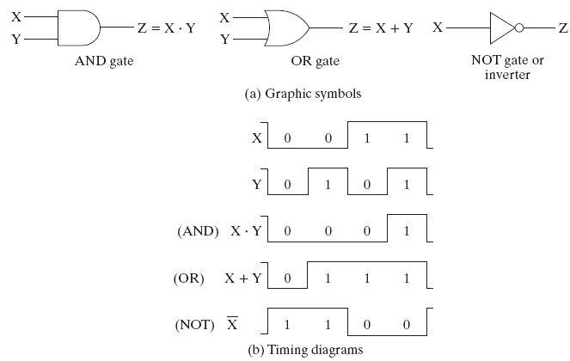
Logic Gate Symbols and Behavior
Logic gates have special symbols:
Chapter 2 - Part 1 <number>

Slide 14
Gate Delay
In actual physical gates, if one or more input changes causes the output to change, the output change does not occur instantaneously.
The delay between an input change(s) and the resulting output change is the gate delay denoted by t_{G}:
1
Input
0
t_{G}
t_{G}
t_{G} = 0.3 ns
1
Output
0
0
0.5
1
1.5
Time (ns)
Chapter 2 - Part 1 <number>

Slide 15
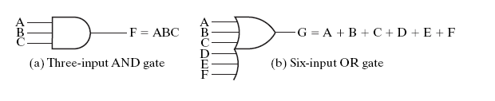
AND and OR gates with more than two inputs
Chapter 2 - Part 1 <number>

Slide 16

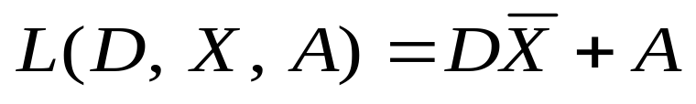
2-2 Boolean Algebra
Boolean expression: a expression formed by binary variables, for example,
Boolean function: a binary variable identifying the function followed by an equal sign and a Boolean expression for example
Chapter 2 - Part 1 <number>

Slide 17
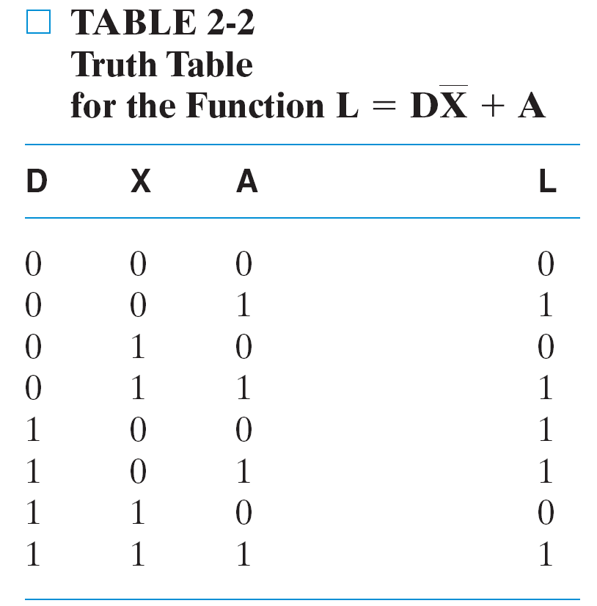
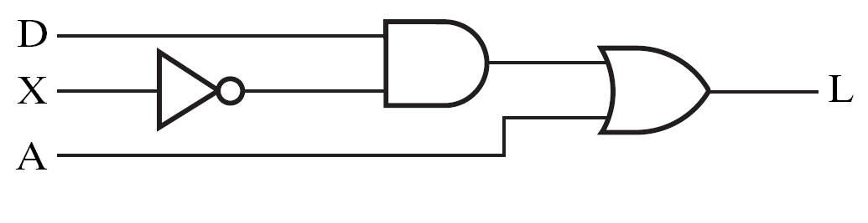
Truth table and Logic circuit
For the Boolean function
_{Fig. 2.3 Logic Circuit Diagram}
Chapter 2 - Part 1 <number>

Slide 18
Basic identities of Boolean Algebra
An algebraic structure defined on a set of at least two elements together with three binary operators (denoted +, · and - ) that satisfies the following basic identities:
1.
X
+ 0
=
X
2.
X
. 1
=
X
3.
X
1
1
4.
X
. 0
0
+
=
=
5.
X + X
=
X
6.
X . X
=
X
7.
X + X
=
1
8.
X . X
=
0
9.
X = X
10.
X + Y
=
Y + X
11.
XY
=
YX
Commutative
12.
(X + Y)
+
Z
=
X + (Y
+
Z)
13.
(XY)
Z
=
X(Y
Z)
Associative
14.
X(Y +
Z)
=
XY
+
XZ
15.
X
+ YZ
=
(X + Y)
(X + Z)
Distributive
DeMorgan
16.
X + Y
=
X . Y
17.
X . Y
=
X + Y
’
s
Chapter 2 - Part 1 <number>

Slide 19
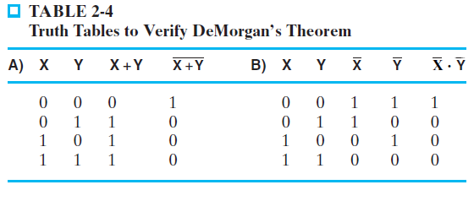
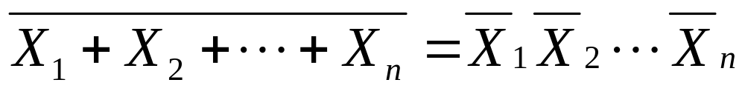
Truth Table to Verify DeMorgan’s Theorem
Extension of DeMorgan’s Theorem:

Slide 20
Some Properties of Identities & the Algebra
If the meaning is unambiguous, we leave out the symbol “·”
The dual of an algebraic expression is obtained by interchanging + and · and interchanging 0’s and 1’s.
The identities appear in dual pairs. When there is only one identity on a line the identity is self-dual, i. e., the dual expression = the original expression.
Chapter 2 - Part 1 <number>

Slide 21
Some Properties of Identities & the Algebra (Continued)
Unless it happens to be self-dual, the dual of an expression does not equal the expression itself.
Example: F = (A + C) · B + 0
dual F = (A · C + B) · 1 = A · C + B
Example: G = X · Y + (W + Z)
dual G =
Example: H = A · B + A · C + B · C
dual H =
Are any of these functions self-dual?
Chapter 2 - Part 1 <number>
Notes:
Dual G = ((X+Y) · (W · Z)') = ((X+Y) ·(W' + Z')
Dual H = (A + B)(A + C)(B + C). Using the Boolean identities,
= (A +BC) (B+C) = AB + AC + BC. So H is self-dual.

Slide 22
Boolean Operator Precedence
The order of evaluation in a Boolean
expression is:
1.
Parentheses
2.
NOT
3.
AND
4.
OR
Example: F = A(B + C)(C + D)
Chapter 2 - Part 1 <number>

Slide 23
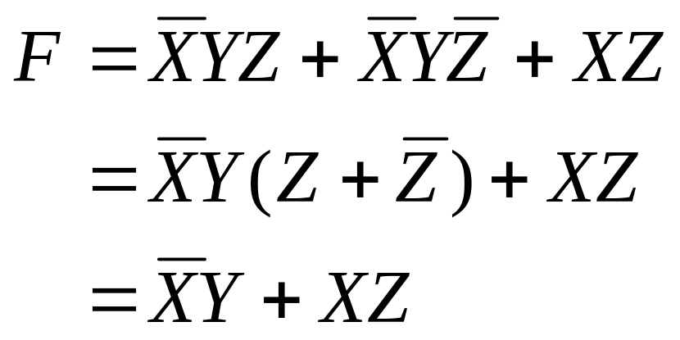
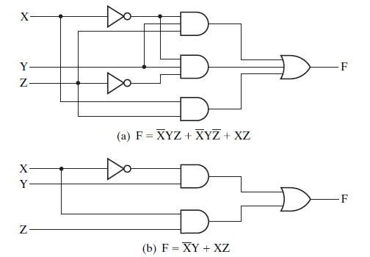
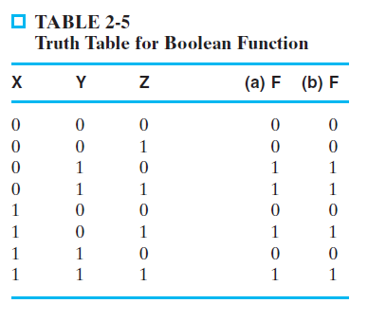
Boolean Algebraic Manipulation
_{Fig. 2-4}
Chapter 2 - Part 1 <number>

Slide 24
Boolean Algebraic Manipulation
AB + AC + BC = AB + AC (Consensus Theorem)
Proof Steps Justification (identity or theorem)
AB + AC + BC
= AB + AC + 1 · BC ?
= AB +AC + (A + A) · BC ?
=
What is the duality?
Chapter 2 - Part 1 <number>
Notes:
Justification 1: 1 . X = X
Justification 2: X + X’ = 1
= AB + A’C + ABC + A’BC X(Y + Z) = XY + XZ (Distributive Law)
= AB + ABC + A’C + A’BC X + Y = Y + X (Commutative Law)
= AB . 1 + ABC + A’C . 1 + A’C . B X . 1 = X, X . Y = Y . X (Commutative Law)
= AB (1 + C) + A’C (1 + B) X(Y + Z) = XY +XZ (Distributive Law)
= AB . 1 + A’C . 1 = AB + A’C X . 1 = X

Slide 25
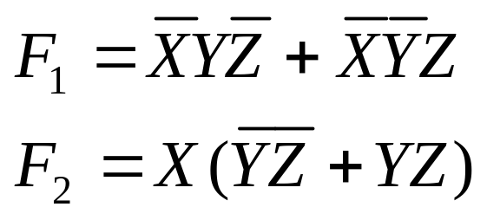
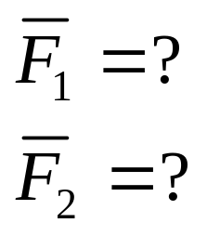
Example: Complementing Function
By DeMorgan’s Theorem (Example 2-2)
By duality (Example 2-3)
Chapter 2 - Part 1 <number>
Notes:
= X’ Y’ Z + X Y’ (A + B)’ = A’ . B’ (DeMorgan’s Law)
= Y’ X’ Z + Y’ X A . B = B . A (Commutative Law)
= Y’ (X’ Z + X) A(B + C) = AB + AC (Distributive Law)
= Y’ (X’ + X)(Z + X) A + BC = (A + B)(A + C) (Distributive Law)
= Y’ . 1 . (Z + X) A + A’ = 1
= Y’ (X + Z) 1 . A = A, A + B = B + A (Commutative Law)

Slide 26
2-3 Canonical Forms
It is useful to specify Boolean functions in a form that:
  Allows comparison for equality.
  Has a correspondence to the truth tables
Canonical Forms in common usage:
  Sum of Minterms (SOM)
  Product of Maxterms (POM)
Chapter 2 - Part 1 <number>

Slide 27
Minterms
Minterms are AND terms with every variable present in either true or complemented form.
Given that each binary variable may appear normal (e.g., x) or complemented (e.g., ), there are 2^{n} minterms for n variables.
Example: Two variables (X and Y)produce
2 x 2 = 4 combinations:
  (both normal)
  (X normal, Y complemented)
  (X complemented, Y normal)
  (both complemented)
Thus there are four minterms of two variables.
x
XY
X
Y
X
Y
X
Y
Chapter 2 - Part 1 <number>

Slide 28
Maxterms
Maxterms are OR terms with every variable in true or complemented form.
Given that each binary variable may appear normal (e.g., x) or complemented (e.g., x), there are 2^{n} maxterms for n variables.
Example: Two variables (X and Y) produce
2 x 2 = 4 combinations:
  (both normal)
  (x normal, y complemented)
  (x complemented, y normal)
  (both complemented)
X
+
Y
X
+
Y
X
+
Y
X
+
Y
Chapter 2 - Part 1 <number>

Slide 29
Maxterms and Minterms
Examples: Two variable minterms and maxterms.
The index above is important for describing which variables in the terms are true and which are complemented.
Index | Minterm | Maxterm
0 | x y | x + y
1 | x y | x + y
2 | x y | x + y
3 | x y | x + y
Chapter 2 - Part 1 <number>

Slide 30
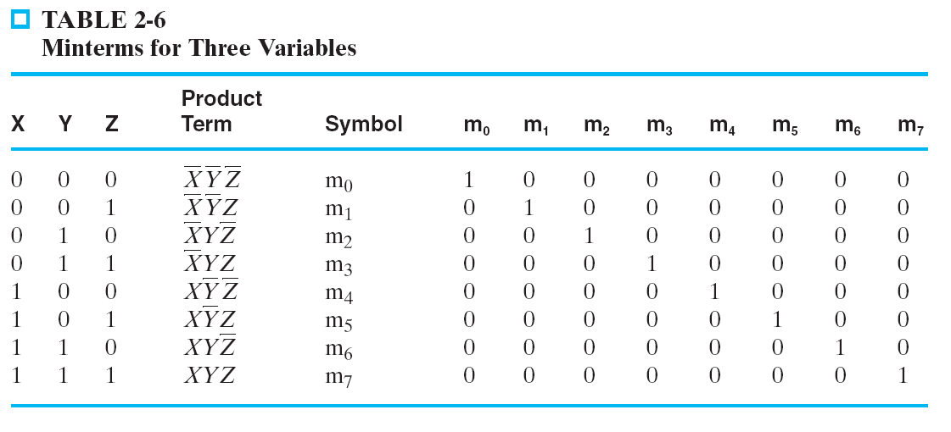
Minterms for three variables
Chapter 2 - Part 1 <number>

Slide 31

Chapter 2 - Part 1 <number>

Slide 32
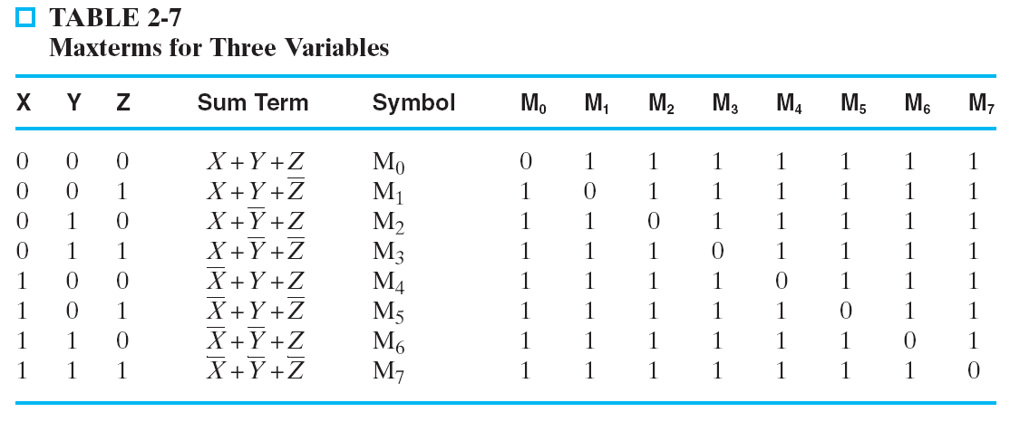
Maxterms for three variables
Chapter 2 - Part 1 <number>

Slide 33
Minterm and Maxterm Relationship
Review: DeMorgan's Theorem
and
Two-variable example:
and
Thus M₂ is the complement of m₂ and vice-versa.
Since DeMorgan's Theorem holds for n variables, the above holds for terms of n variables
giving:
and
Thus M_{i} is the complement of m_{i}.
x
·
y
=
x
+
y
x
+
y
=
x
⋅
y
M
=
x
+
y
m
=
x·
y
2
2
M
=
m
m
=
M
i
i
i
i
Chapter 2 - Part 1 <number>

Slide 34
Function Tables for Both
Minterms of Maxterms of
2 variables 2 variables
Each column in the maxterm function table is the complement of the column in the minterm function table since M_{i} is the complement of m_{i}.
x y
m
m
m
m
x y
M
M
M
M
0
1
2
3
0
1
2
3
0 0
1
0
0
0
0 0
0
1
1
1
0 1
0
1
0
0
0 1
1
0
1
1
1 0
0
0
1
0
1 0
1
1
0
1
1 1
0
0
0
1
1 1
1
1
1
0
Chapter 2 - Part 1 <number>

Slide 35
Observations
In the function tables:
  Each minterm has one and only one 1 present in the 2^{n} terms (a minimum of 1s). All other entries are 0.
  Each maxterm has one and only one 0 present in the 2^{n} terms All other entries are 1 (a maximum of 1s).
We can implement any function by "ORing" the minterms corresponding to "1" entries in the function table. These are called the minterms of the function.
We can implement any function by "ANDing" the maxterms corresponding to "0" entries in the function table. These are called the maxterms of the function.
This gives us two canonical forms:
  Sum of Minterms (SOM)
  Product of Maxterms (POM)
for stating any Boolean function.
Chapter 2 - Part 1 <number>

Slide 36
Conversion of Minterm and Maxterm
Chapter 2 - Part 1 <number>

Slide 37
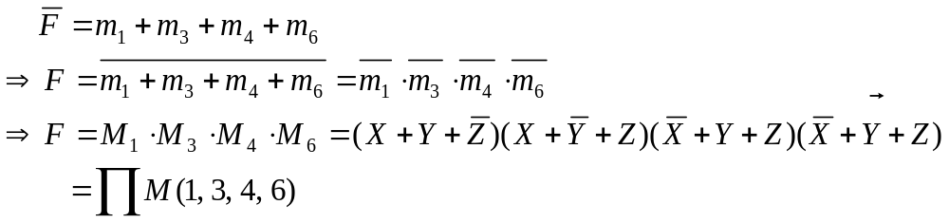
Conversion of Minterm and Maxterm
Chapter 2 - Part 1 <number>

Slide 38
Canonical Sum of Minterms
Any Boolean function can be expressed as a Sum of Minterms.
  For the function table, the minterms used are the terms corresponding to the 1's
  For expressions, expand all terms first to explicitly list all minterms. Do this by “ANDing” any term missing a variable v with a term ( ).
Example: Implement as a sum of minterms.
  First expand terms:
  Then distribute terms:
  Express as sum of minterms: f = m₃ + m₂ + m₀
v
+
v
f
=
x
+
x
y
f
=
x
(
y
+
y
)
+
x
y
f
=
xy
+
x
y
+
x
y
Chapter 2 - Part 1 <number>

Slide 39

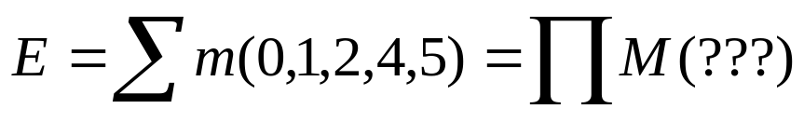
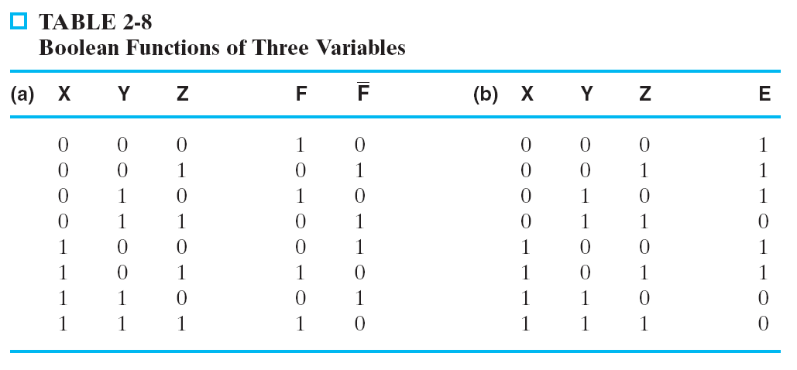
Another SOM Example
Expand by using truth table
According to truth table Table 2-8,
Chapter 2 - Part 1 <number>
Notes:
F = A(B + B’)(C + C’) + (A + A’) B’ C
= ABC + ABC’ + AB’C + AB’C’ + AB’C + A’B’C
= ABC + ABC’ + AB’C + AB’C’ + A’B’C
= m7 + m6 + m5 + m4 + m1 = m1 + m4 + m5 + m6 + m7

Slide 40
Standard Sum-of-Products (SOP)
A sum of minterms form for n variables can be written down directly from a truth table.
  Implementation of this form is a two-level network of gates such that:
  The first level consists of n-input AND gates, and
  The second level is a single OR gate (with fewer than 2^{n} inputs).
This form often can be simplified so that the corresponding circuit is simpler.
Chapter 2 - Part 1 <number>

Slide 41

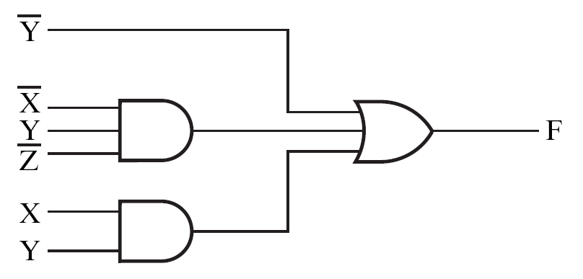
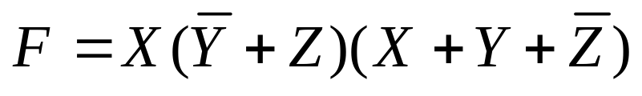
Standard Sum-of-Products (SOP)
Example:
Fig. 2-5
a two-level implementation/two-level circuit
Product-of-Sums (POS):
What’s the implementation?
Chapter 2 - Part 1 <number>
Notes:
F = A’ B’ C + A (B’ C’ + B C’ + B’ C + B C)
= A’ B’ C + A (B’ + B) (C’ + C)
= A’ B’ C + A.1.1
= A’ B’ C + A
= B’C + A

Slide 42
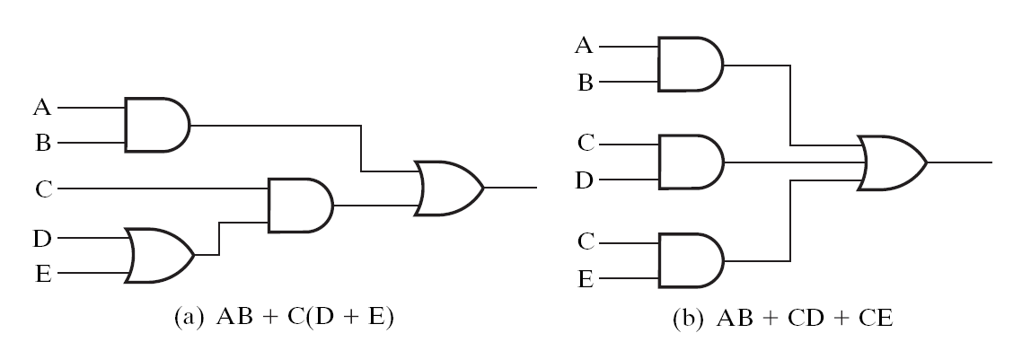
Convert non-SOP expression to SOP expression
The decision whether to use a two-level or multiple-level implementation is complex.
  no. of gates
  No. of gate inputs
  amount of time delay
Chapter 2 - Part 1 <number>

Slide 43
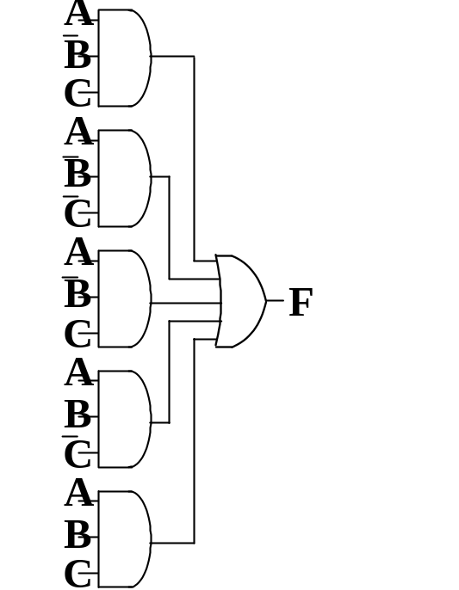
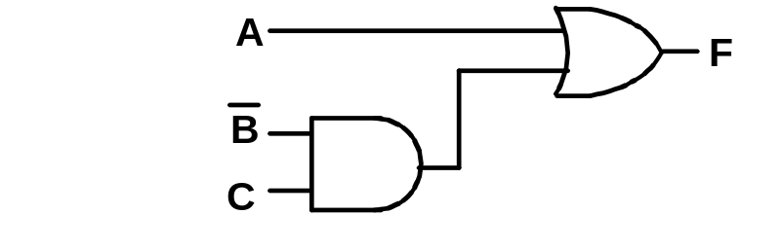
Simplification of two-level implementation of SOP expression
The two implementations for F are shown below – it is quite apparent which is simpler!
Chapter 2 - Part 1 <number>

Slide 44
SOP and POS Observations
The previous examples show that:
  Canonical Forms (Sum-of-minterms, Product-of-Maxterms), or other standard forms (SOP, POS) differ in complexity
  Boolean algebra can be used to manipulate equations into simpler forms.
  Simpler equations lead to simpler two-level implementations
Questions:
  How can we attain a “simplest” expression?
  Is there only one minimum cost circuit?
  The next part will deal with these issues.
Chapter 2 - Part 1 <number>

